Slide 1

DEEP LEARNING
Brain Tumour Classification
Srinidhi Tarigoppula (21011101128)
Shaik Teeb Hussain (21011101115)
AI&DS-B
Shiv Nadar University Chennai

Slide 2

INTRODUCTION
Problem Statement
To develop an accurate tumor segmentation method using the Few-Shot learning technique to carry out the work on pre-operative multimodal MRI scans.
Dataset Link: https://www.kaggle.com/datasets/awsaf49/brats20-dataset-training-validation

Slide 3
Objective
Four distinct tumoral subregions defined from MRI: the “enhancing tumor” (ET), the “non enhancing tumor” (NET) and the “necrotic tumor” (NCR) and the “peritumoral edema” (ED).
ET is the first cluster; addition of ET, NET and NCR represents the “tumor core” (TC) region; and addition of ED to TC represents the “whole tumor” (WT).
To segment the gliomas in pre-operative MRI scans the sub-regions of tumor considered for evaluation, including:
1) the "enhancing tumor" (ET),
2) the "tumor core" (TC),
3) the "whole tumor" (WT).

Slide 4
Motivation
Magnetic Resonance Imaging (MRI) and resection surgery are the most common diagnosis and treatment for brain tumor.
A priority for a neurosurgeon is to mark the tumor region precisely which is a very laborious task. Due to inevitable practical operation factors, it is difficult to replicate a segmentation result exactly the same.
With the goal of aiding neurosurgeons in this task we take up the problem of brain tumor segmentation, the task of segmenting tumors from other brain tissues in magnetic resonance imaging (MRI) pictures of the brain.

Slide 5
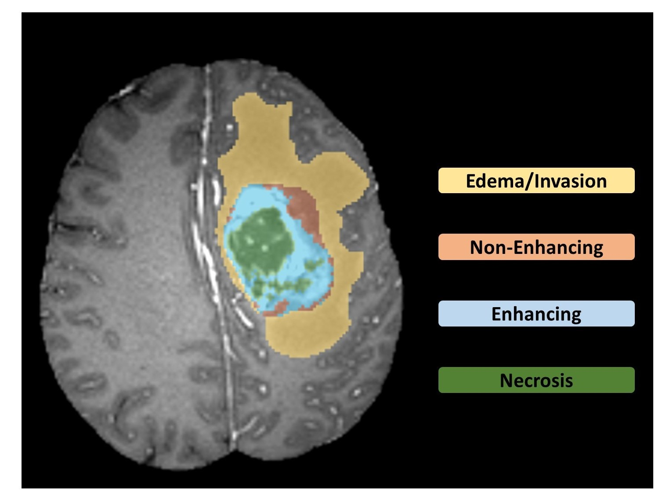
Tumoral Subregions

Slide 6
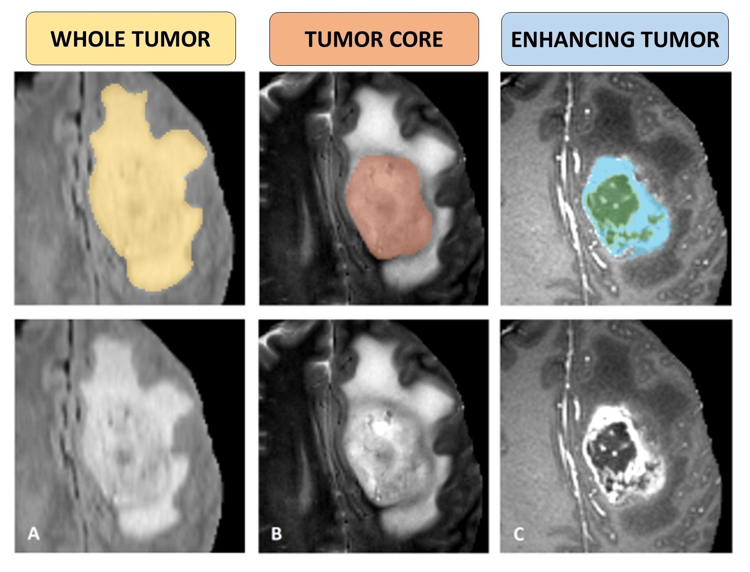
Tumor Clusters

Slide 7
METHODOLOGY
U-Net (Base Architecture)
What is U-Net?
U-Net is a convolutional neural network architecture that expanded with few changes in the CNN architecture.
In total the network has 23 convolutional layers.
It was invented to deal with biomedical images where the target is not only to classify whether there is an infection or not but also to identify the area of infection.
Why U-Net?
U-Net is more successful than conventional models, in terms of architecture and in terms pixel-based image segmentation formed from convolutional neural network layers.
It's even effective with limited dataset images.

Slide 8
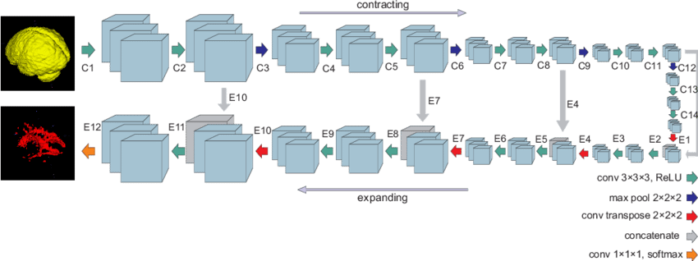
U-Net Architecture

Slide 9
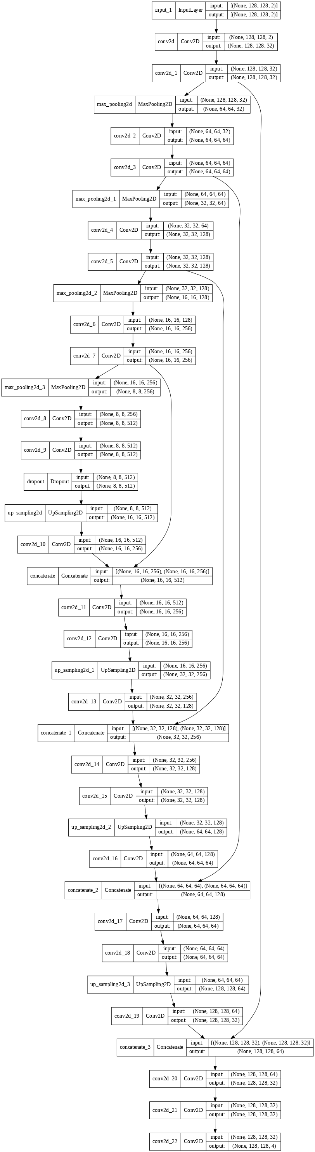
U-Net Architecture Model Implemented
U-Net with 23-layer CNN
A realistic view of how the architecture is during implementation via code. The U shape, formed by the contracting and expanding paths, from which the architecture derives its name is visible here.

Slide 10
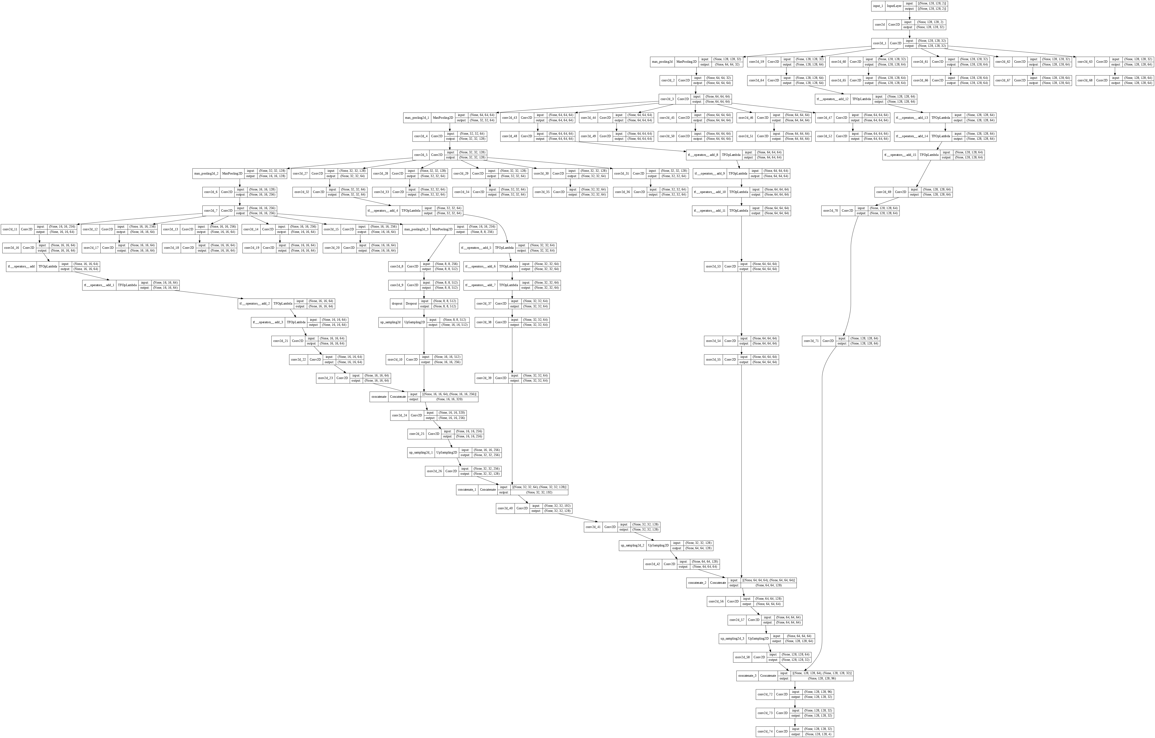
Modified U-Net with added RES Blocks
A realistic view of the modified architecture during implementation via code.

Slide 11
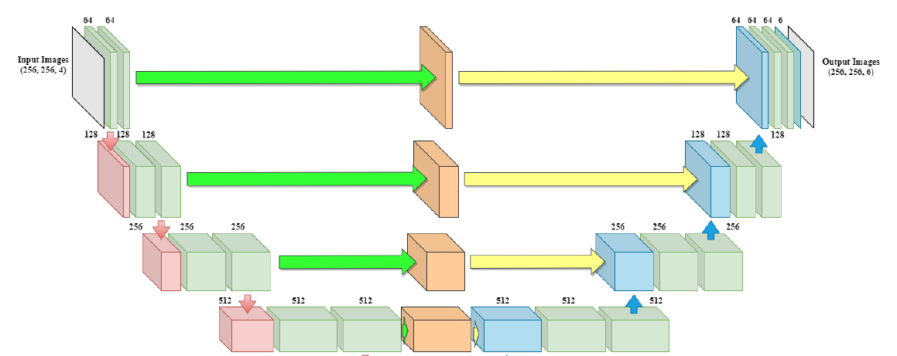


Simplified Diagram Showing U-Net Architecture with RES Blocks

Slide 12
Software Requirements
Brain Tumor Segmentation (BraTS) Dataset 2021
Anaconda - Jupyter Notebook
NumPy
Pandas
Keras
Scikit-learn
TensorFlow

Slide 13
Refinements
To modify the architecture of the U-Net further by introducing more hybrid blocks to refine segmentation and control degradation of information
Compiling the results of the experiments and comparing with other state-of-the-art methods

Slide 14
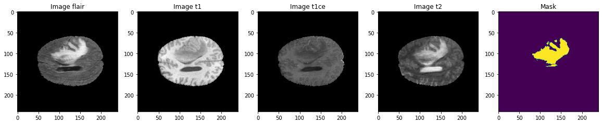
STUDIES
Details of Dataset (https://www.kaggle.com/datasets/awsaf49/brats20-dataset-training-validation)
The following illustration shows the different MRI sequences taken from a slice of the scan given in as input. An MRI sequence is a number of radiofrequency pulses and gradients that result in a set of images with a particular appearance.
T1 - fat suppressed
T2 - fat suppressed, fluid attenuated, susceptibility sensitive
T1ce - a T1 sequence coupled with injections of gadolinium as a contrast agent
FLAIR - detect parenchymal edema without the glaring high signal from CSF

Slide 15
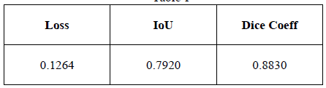
Base Architecture Result
After performing data generation, data augmentation and adjusting the data, the U-Net training is performed on the final dataset at a learning rate of 0.0001 and 100 epochs. The model performance is visualized on 3 main factors: Loss function, Intersection over Union (IoU) and Dice Coefficient.

Slide 16
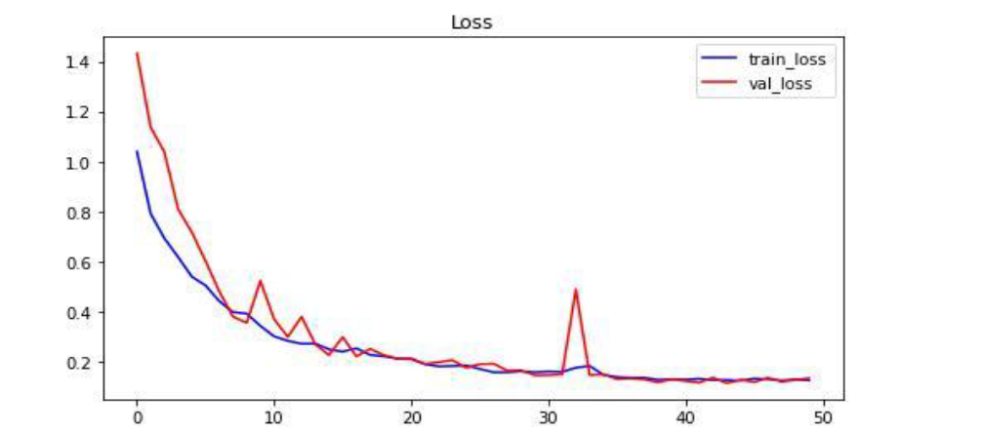
TRAIN LOSS, DICE COEFFICIENT AND IOU CHARTS FOR THE BASE MODEL

Slide 17
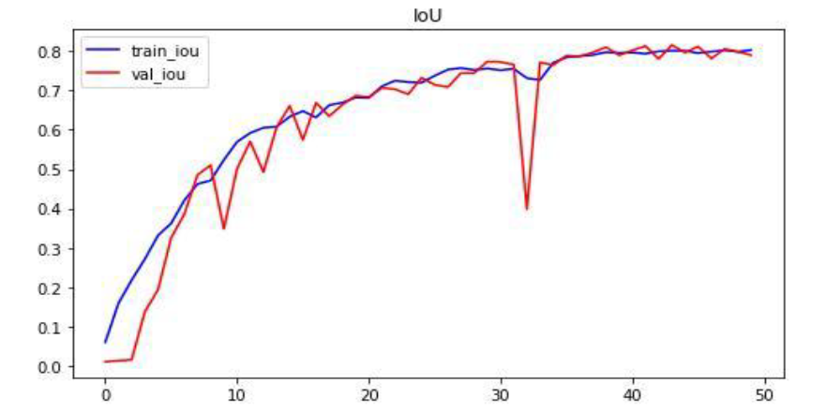

Slide 18
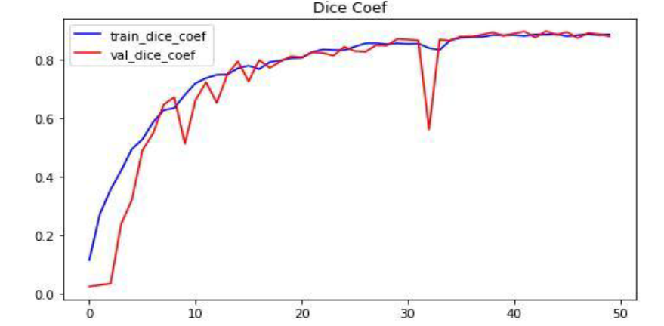

Slide 19
RESULTS
With modified U-Net architecture with RES blocks:
Parameters | Simple U-Net
Accuracy | 0.9924
Precision | 0.9931
Sensitivity | 0.9910
Specificity | 0.9977
Dice Coefficient | 0.5993

Slide 20


